Slide 1
V
C
C
In_a
In_b
In_c
In_d
W_a
Out_a
W_b
R
Stile
R
W_c
W_d
Out_a = In_a×W_a + In_b×W_b + In_c×W_c + In_d×W_d

Slide 2



$MM$ kernel
$Data_{in}$
kernel
Accumulate structure
$Data_{out}$
kernel
X
…
+
X
FIFO
Buffer1
+
FIFO
X
+
X
…
Dot product unit
Accumulating Tile
Buffer2
DDR3 on Catapult FPGA

Slide 3
Input Feature Maps
Input Matrix
An Example Tile
0 1 2
3 4 5
6 7 8
0 1 3 4 9 10 12 13
1 2 4 5 10 11 13 14
Random Access
0 1 2 3 4 5 6 7 8 9 10 11 12 13 14 15 16 17 · · ·
Conventional DRAM Layout

Slide 4
Input Feature Maps
Input Matrix
Reorganized Tile
0 1 2
3 4 5
6 7 8
0 9 1 10 3 12 4 14
1 10 2 11 4 13 5 14
Sequential Access
0 9 1 10 2 11 3 12 4 13 5 14 6 15 7 16 8 17 · · ·
Optimized DRAM Layout

Slide 5
Host
(CPU)
PCI-e
Device
(FPGA)
C/C++
Programs
OpenCL
Programs

Slide 6
Model Descriptions
Behavior Script
Host
Symbolic Compiler
Hardware Template
FPGA
Hardware
Synthesis
Parameters

Slide 7
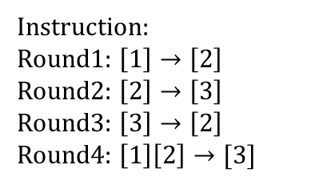
1
Storage Unit
Execution Unit
Previous Elewise add
2
1
2
3
Conv
Conv
3
+
Conv
Conv
2
Instruction:
Round1: $\left[1\right]→\left[2\right]$
Round2: $\left[2\right]→\left[3\right]$
Round3: $\left[3\right]→\left[2\right]$
Round4: $\left[1\right]\left[2\right]→[3]$
Elewise add
3
a) Unified Symbolic Expression
b) Data Flow Graph
c) Storage Unit Mapping
d) Execution Unit Reusing (final hardware)

Slide 8
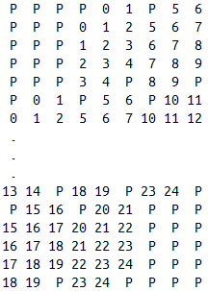


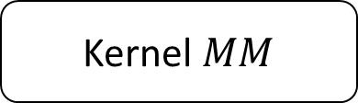

One DDR burst (64X8 bits)
DDR for input feature maps:
DDR sequential read
DDR for input filters:
Fetch direction inside a tile
Tile B
Tile A
Kernel $Data_{in}$
Kernel$MM$
Kernel $Data_{out}$
Tile C
DDR for output feature maps:

Slide 9
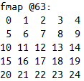
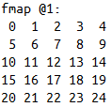

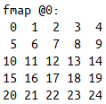
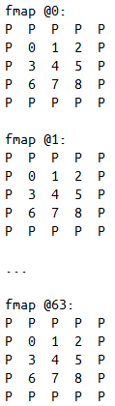
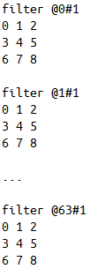
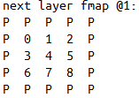
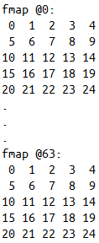
fmap @0
filter [@0..@63]#0
next layer fmap @0
fmap @1
filter [@0..@63]#1
next layer fmap @1
...
...
...
fmap @63
filter [@0..@63]#31
next layer fmap @63
fmap @0
filter @0#0
fmap @1
filter @1#0
next layer fmap @0
...
...
conv
fmap @63
filter @63#0
conv
sum up
conv

Slide 10







$$L$$
$$C_{tile b}$$
$$R_{tile a}$$
A1
A2
A3
A4
A5
A6
$$L$$
B1
B2
B3
B4
B5
B6
$$C_{tile b}$$
$$R_{tile a}$$
C
$$C=\sum_{i=1}^{6}{A_{i}×B_{i}}$$

Slide 11
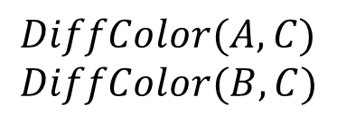

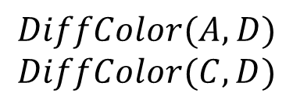
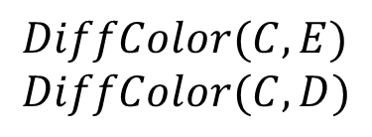
0
A
A
B
$$DiffColor(A,B)$$
1
B
C
E
E
C
D
D
$$DiffColor(A, C)$$
$$DiffColor(B,C)$$
A
A
B
$$DiffColor(A, D)$$
$$DiffColor(C,D)$$
B
C
E
E
2
C
D
D
3
A
B
$$DiffColor(C, E)$$
$$DiffColor(C, D)$$
E
4
C
D
buf2
buf1
A
B
A
B
Graph Color solver
C
E
C
buf0
E
D
buf2
D
buf1

